Slide 1
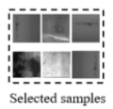

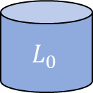
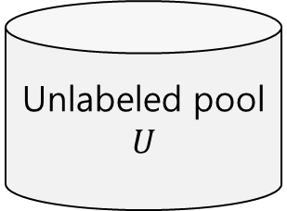
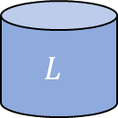
$${ L}_{0}$$
Labeled
Training set
Initial Training
Or Pre-training
Unlabeled pool
$$U$$
Semi-supervised
Learning
Deep learning model
pseudo
Batch
Labeling
Sampling
Update dataset
Training model
$$L$$
Labeled
Training set

